Slide 1





Lawgorithm
Nice To E-Meet You 2
Nice To E-Meet You 2
Title

Slide 2







Pain Points in Law
Why Statute Retrieval Remains a Problem?
Time-Consuming Manual Search
Risk of Overlooking Relevant Provisions
Lack of automated tools to suggest the right provisions
Nice To E-Meet You 2

Slide 3



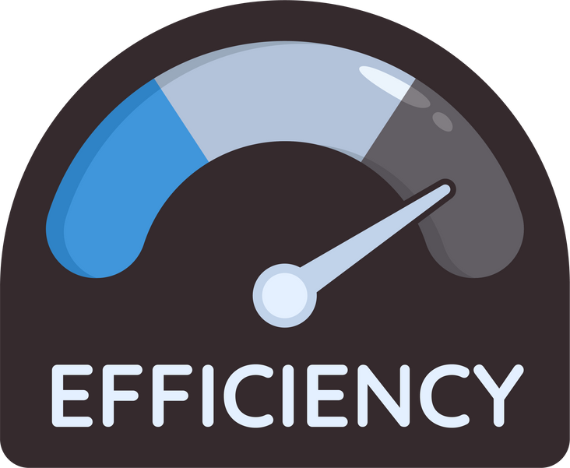


“Think like a Lawyer”
Nice To E-Meet You 2

Slide 4
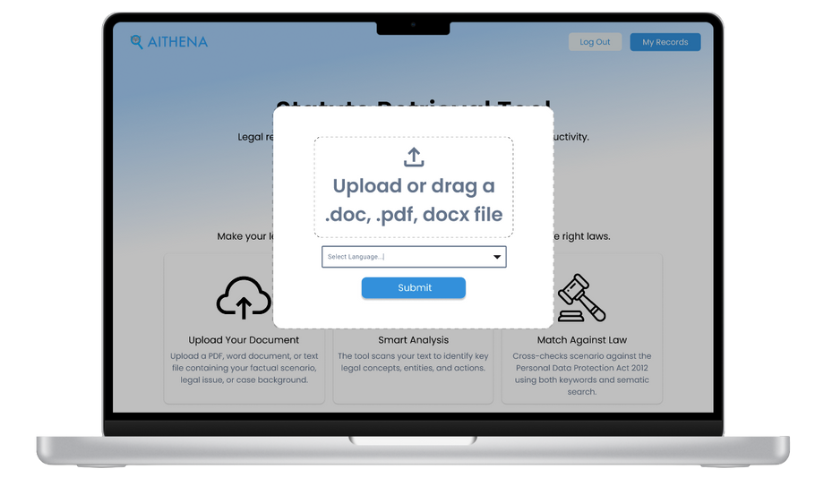
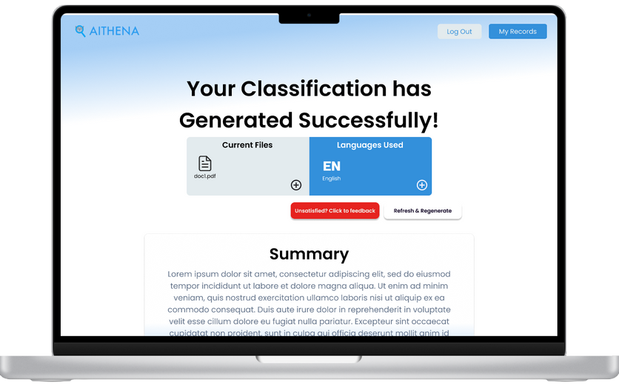
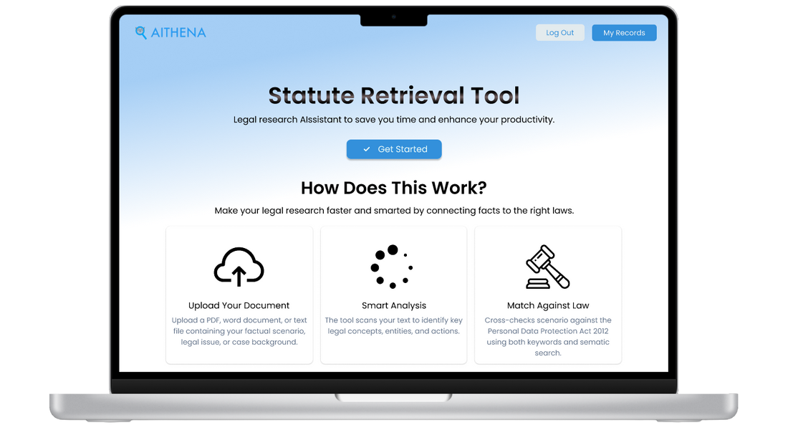

User Interface
Nice To E-Meet You 2

Slide 5


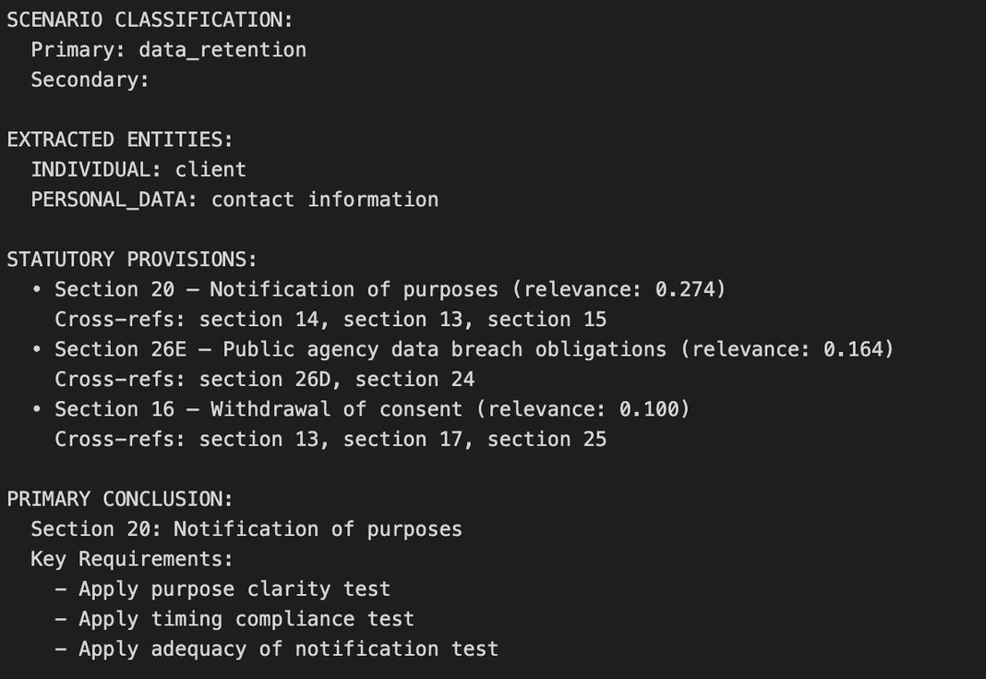
Our Code Output
Nice To E-Meet You 2

Slide 6

Demo Time
Nice To E-Meet You 2

Slide 7

Nice To E-Meet You 2

